Slide 1
641 PROJECT
OPTIMISED TEAM-MAKER
TOOL REQUIREMENTS

Slide 2


Slide 3
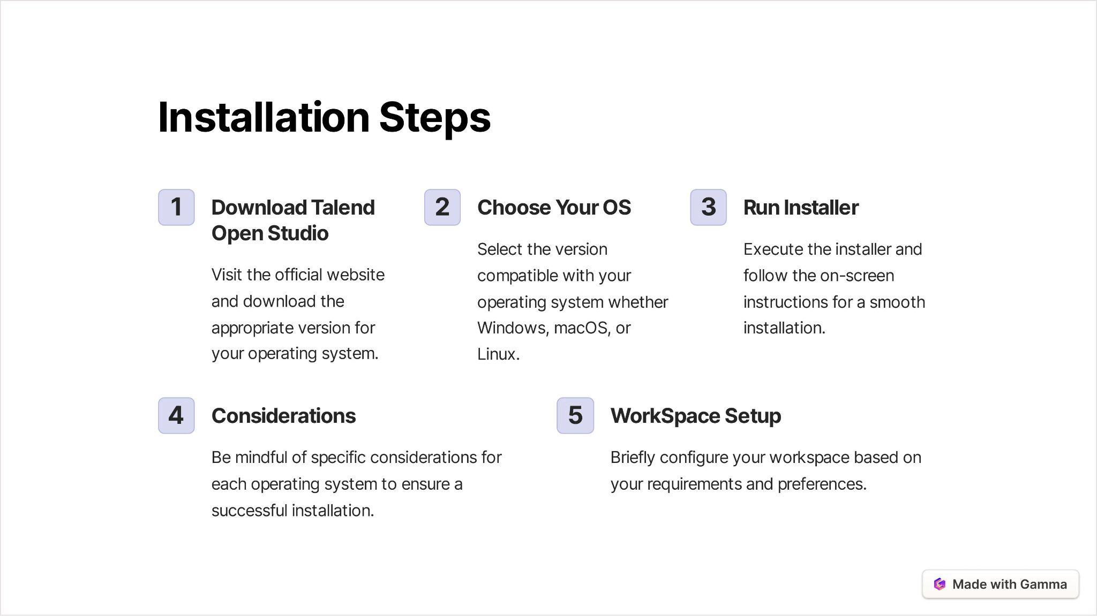

Slide 4
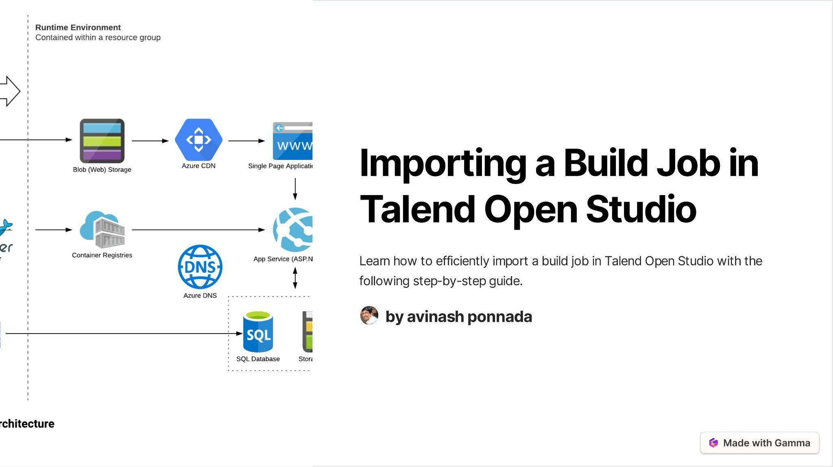

Slide 5
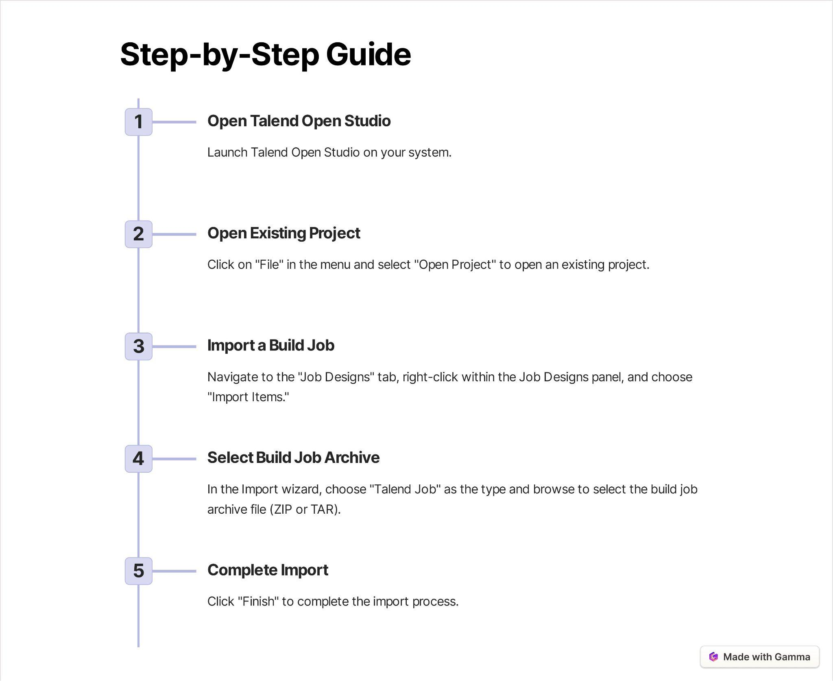

Slide 6


Slide 7
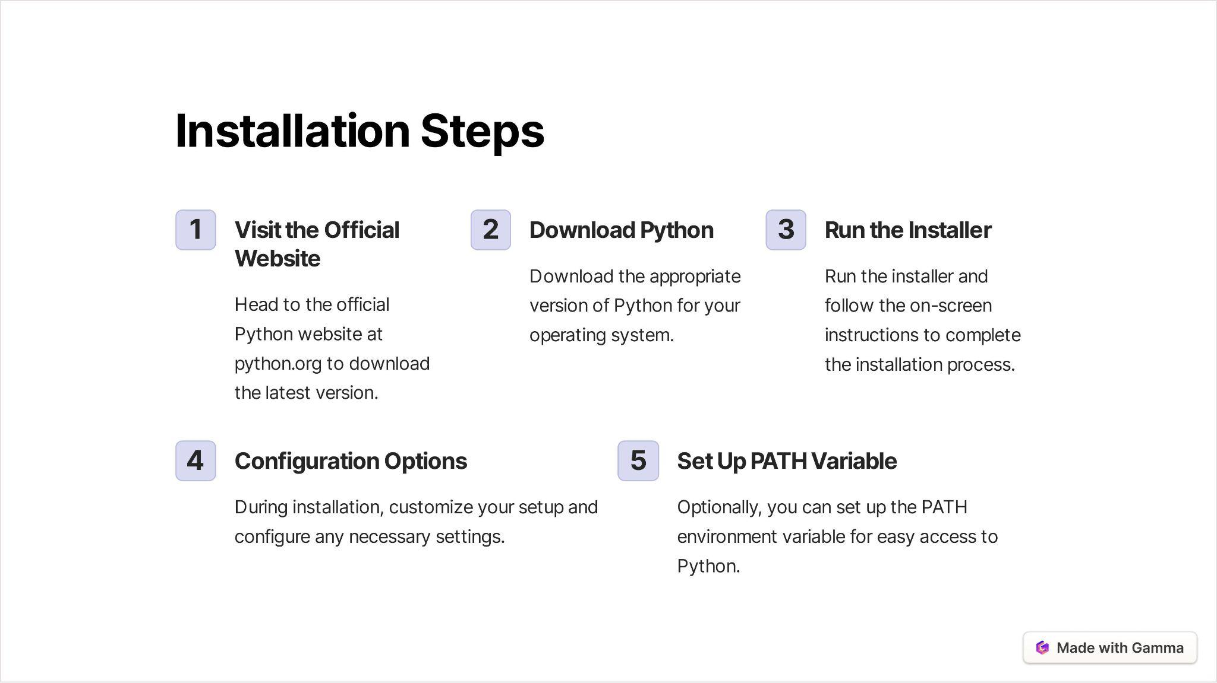

Slide 8
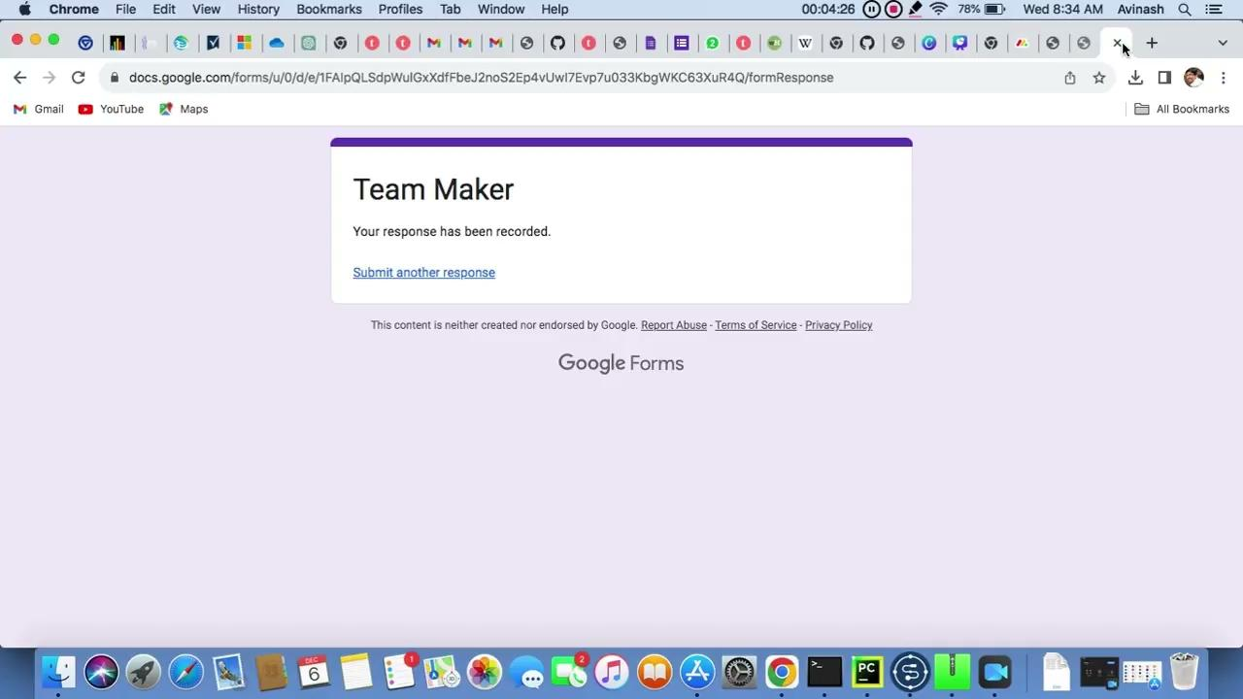
Notes:
ADDING DETAILS

Slide 9
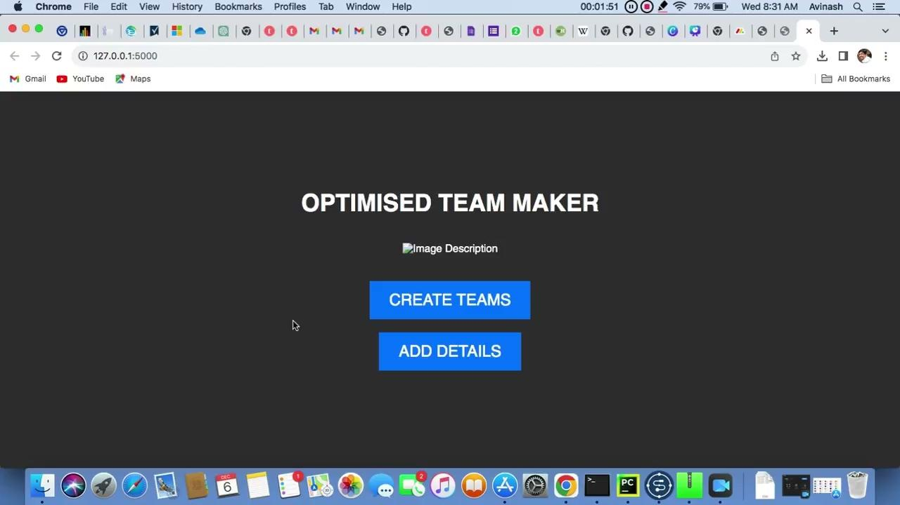
Notes:
GET TEAM DETAILS

Slide 10
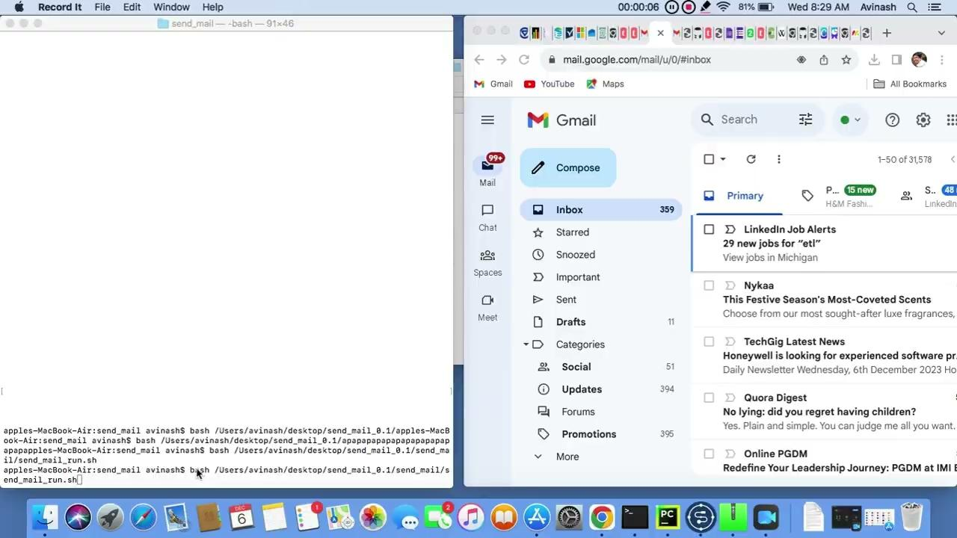
Notes:
SEND TEAM DETAILS

Slide 11
THANK YOU

